Slide 1
INTERNET OF THINGS

Slide 2
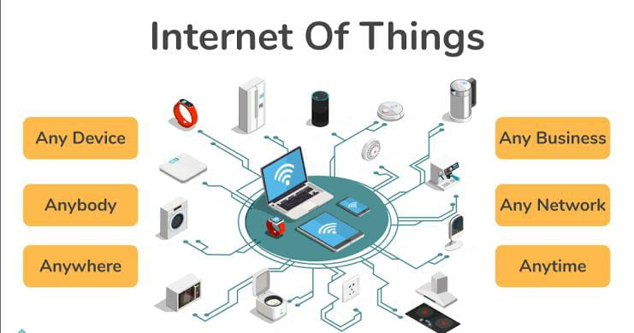
INTRODUCTION OF IOT

Slide 3
INTRODUCTION
The Internet of Things (IOT) describes physical objects (or groups of such objects), that are embedded with sensors, processing ability, software, and other technologies, and that connect and exchange data with other devices and systems over the Internet or other communications networks.
The Internet of Things refers to the rapidly growing network of connected objects that are able to collect and exchange data in real time using embedded sensors. Thermostats, cars, lights, refrigerators, and more appliances can all be connected to the IoT.
Examples of IOT are smart home, smart watches, smart mirrors etc.

Slide 4
Things or devices : Devices and sensors are the components of the device connectivity layer. These smart sensors are continuously collecting data from the environment and transmit the information to the next layer.
Example Pulse Sensor - Heart Rate Detector ,Temperture Sensor, Humidity Sensor, Motion Sensor
Gateway : IoT Gateway manages the bidirectional data traffic between different networks and protocols. Another function of gateway is to translate different network protocols and make sure interoperability of the connected devices and sensors.
Cloud : Internet of things creates massive data from devices, applications and users which has to be managed in an efficient way. IOT cloud offers tools to collect, process, manage and store huge amount of data in real time. Industries and services can easily access these data remotely and make critical decisions when necessary.
Analytics : Analytics is the process of converting analog data from billions of smart devices and sensors into useful insights which can be interpreted and used for detailed analysis. Smart analytics solutions are inevitable for IoT system for management and improvement of the entire system.

Slide 5
PROJECT
CONTROL LED USING RASPBERRY PI AND TELEGRAM BOT
Telegram is an instant messaging app based on cloud. Telegram is almost similar to Whatsapp and available for all devices like Android, IOS, Windows, Mac and linux. User can send stickers, messages Pics, audio files and videos. So, Telegram has an API bot that allows the human to talk to machines. Telegram bot is like a robot which programmed with a set of instruction and answer to interact with the user.

Slide 6
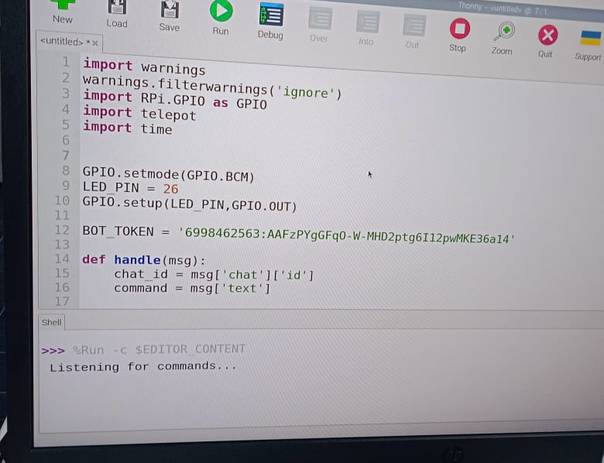
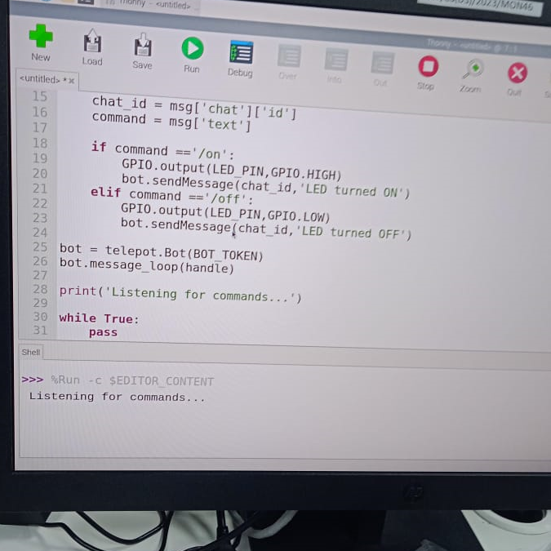
CODE

Slide 7
Raspberry Pi setup for Telegram Bot
Start with installing the teleport library on your Pi. Type the below command in the terminal to install it:
pip install telepot

Slide 8
COMPONENTS REQUIRED
Raspberry Pi
LED
Breadboard
Resistor (250 ohm)
Jumper Wires

Slide 9
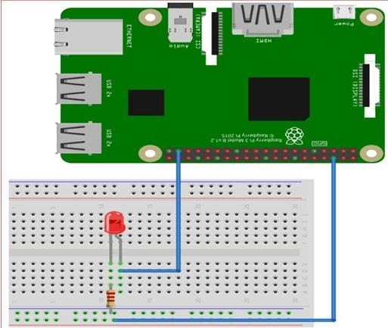
CIRCUIT DIAGRAM
Raspberry pi interfacing with LED

Slide 10
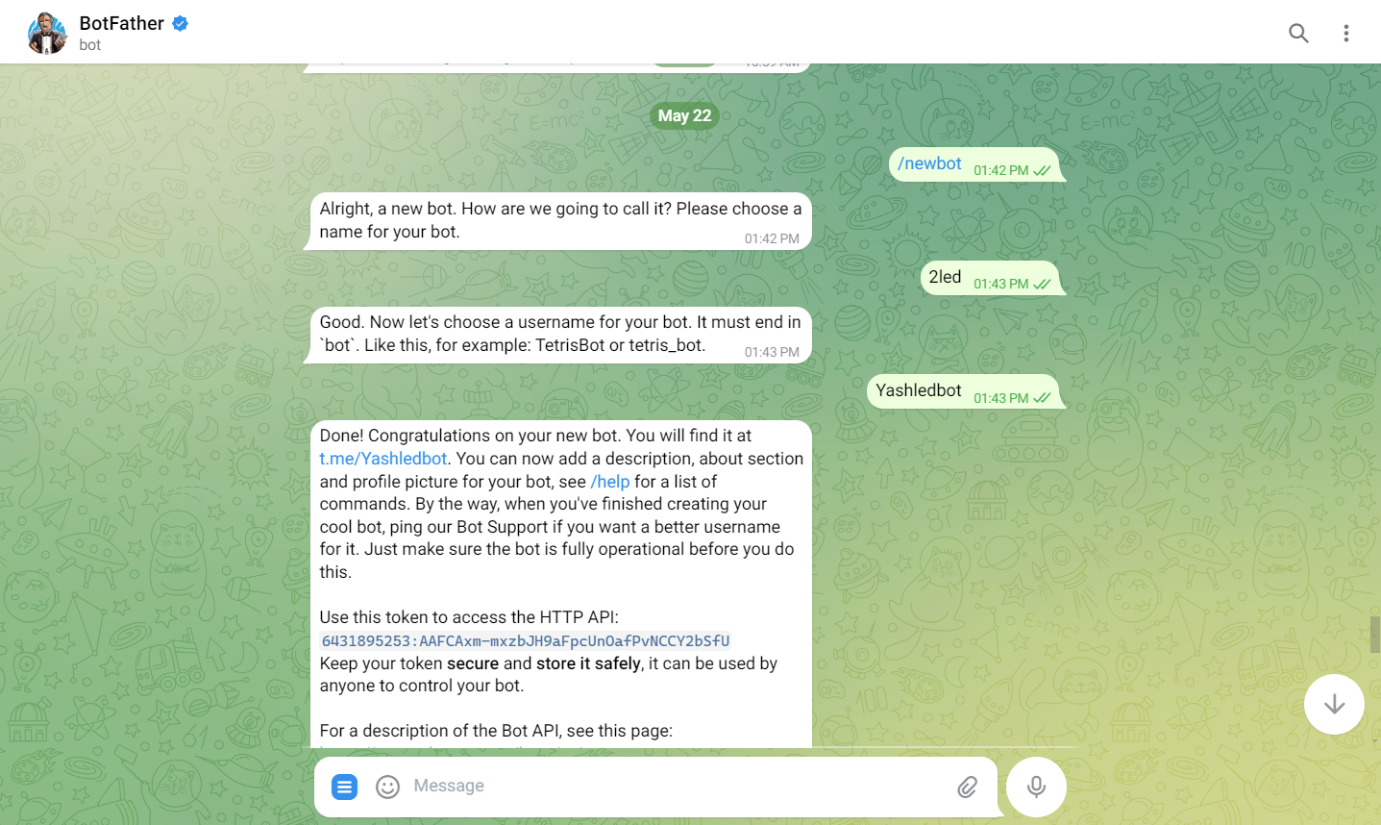
Bot setup in mobile

Slide 11
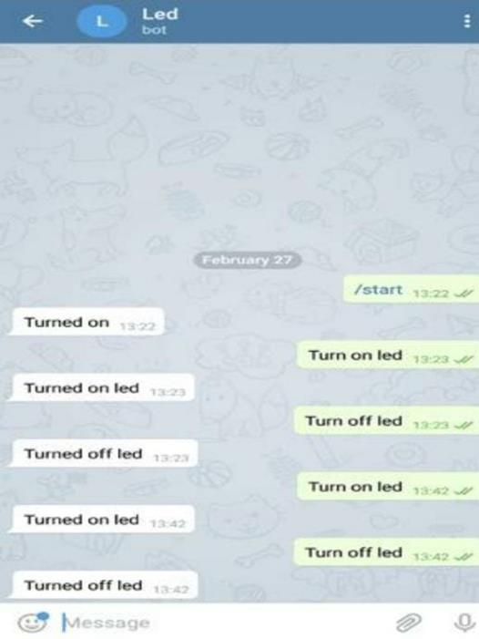
OUTPUTS
Telegram bot responding and turning ON\OFF LED on give commands

Slide 12
THANKYOU

